Slide 1
Window Programming 2-2
Enter & Leave Events
Yuan Ze University

Slide 2
Enter & Leave Events
Enter
  Focus on a component
Leave
  Lost focus

Slide 3
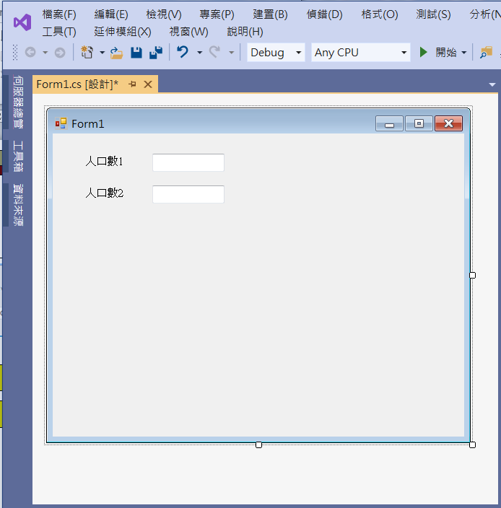
Edit interface
label1
testBox1
label2
testBox2

Slide 4
Add event functions
private void Form1_Load(object sender, EventArgs e)
{
textBox1.ForeColor = Color.Red;
textBox1.BackColor = Color.Black;
textBox2.ForeColor = Color.Red;
textBox2.BackColor = Color.White;
}

Slide 5
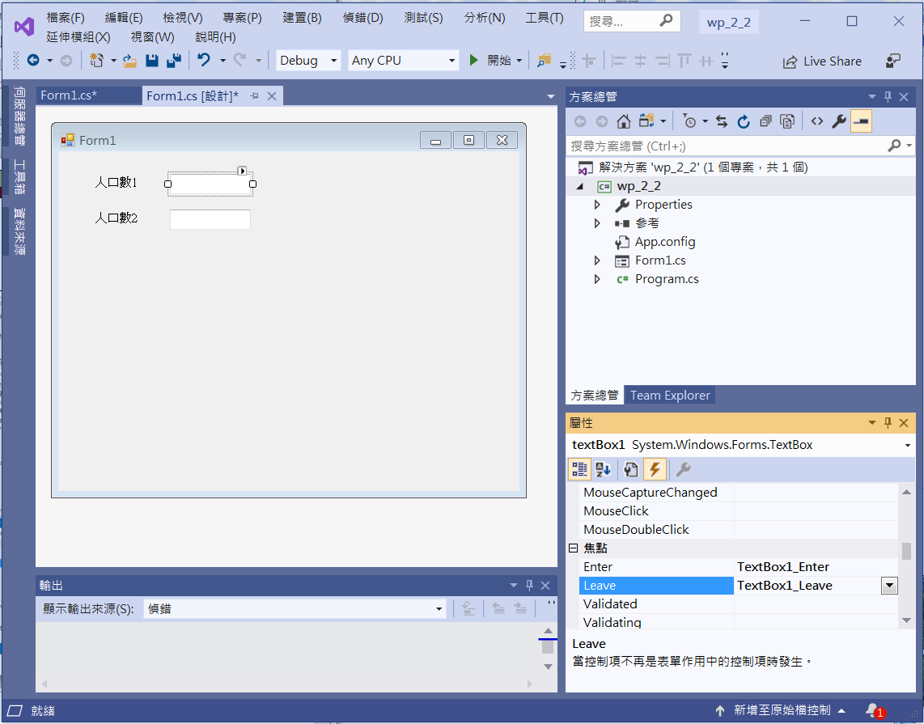
Add event functions
Double Click at Enter
to generate event function
Double Click at Leave

Slide 6
Add event functions
private void TextBox1_Enter(object sender, EventArgs e)
{
if (textBox1.Text != String.Empty)
{
textBox1.ForeColor = Color.Red;
textBox1.BackColor = Color.Black;
}
}
private void TextBox1_Leave(object sender, EventArgs e)
{
textBox1.ForeColor = Color.Black;
textBox1.BackColor = Color.White;
}

Slide 7
Add event functions
private void textBox2_Enter(object sender, EventArgs e)
{
if (textBox2.Text != String.Empty)
{
textBox2.ForeColor = Color.Red;
textBox2.BackColor = Color.White;
}
}
private void textBox2_Leave(object sender, EventArgs e)
{
textBox2.ForeColor = Color.Black;
textBox2.BackColor = Color.White;
}

Slide 8
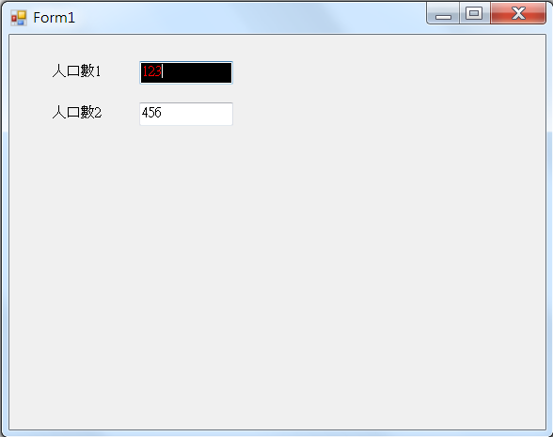
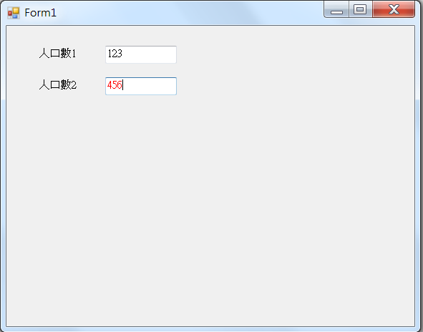
Exercise#2-2

Slide 9
內容來源
  Visual C# 2013視窗程式設計(黃聰明/著; 松崗)
  跟著範例學會Visual C# 2015(張逸中/著; 博碩)

